Slide 1

Natural Language Processing
Yue Zhang
Westlake University

Slide 2
Chapter 1
Introduction

Slide 3
Contents
1.1 What is Natural Language Processing (NLP)?
1.2 NLP tasks
1.2.1 Fundamental NLP tasks
1.2.2 Information Extraction tasks
1.2.3 Text generation Tasks
1.2.4 Other Applications
1.3 NLP from a Machine Learning Perspective

Slide 4
Contents
1.1 What is Natural Language Processing (NLP)?
1.2 NLP tasks
1.2.1 Fundamental NLP tasks
1.2.2 Information Extraction tasks
1.2.3 Text generation Tasks
1.2.4 Other Applications
1.3 NLP from a Machine Learning Perspective

Slide 5
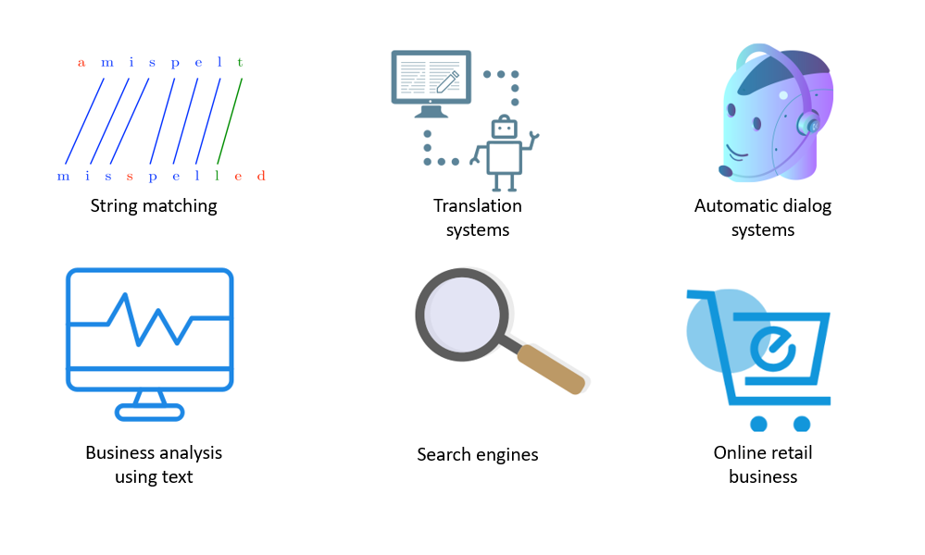
What is NLP?
In the broadest sense, NLP refers to any program that automatically processes human languages

Slide 6
Main approaches
Rule-based (symbolic) approach (1950s-1980s)
The oldest approaches to NLP
Based on human-developed rules and lexicons
Challenges in resolving ambiguities
"The spirit is strong, but the flesh is weak“
"The Vodka is good, but the meat is bad"

Slide 7
Main approaches
Statistical approach (traditional machine learning) (1980s-2000s)
Gradually adopted by both the academia and the industry
Using probabilistic modeling
training data (corpus with markup)
feature engineering
training a model on parameters
applying model to test data

Slide 8
Main approaches
Connectionist approach (Neural networks) (2000s-now)
Deep learning surpasses statistical methods as the domain approach
free from linguistic features
very large neural models
pre-training over large raw text

Slide 9
Contents
1.1 What is Natural Language Processing (NLP)?
1.2 NLP tasks
1.2.1 Fundamental NLP tasks
1.2.2 Information Extraction tasks
1.2.3 Text generation Tasks
1.2.4 Other Applications
1.3 NLP from a Machine Learning Perspective

Slide 10
Fundamental Tasks
Computational Linguistics
Phonology
Morphology
Syntax
Semantics
Discourse
Pragmatics

Slide 11
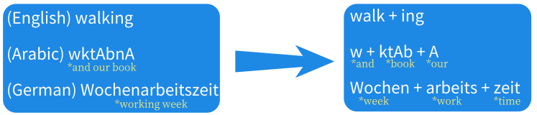

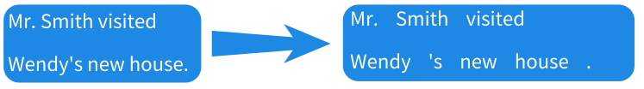
Syntactic tasks: Word level
Morphological analysis
Word segmentation
Tokenization
POS Tagging

Slide 12
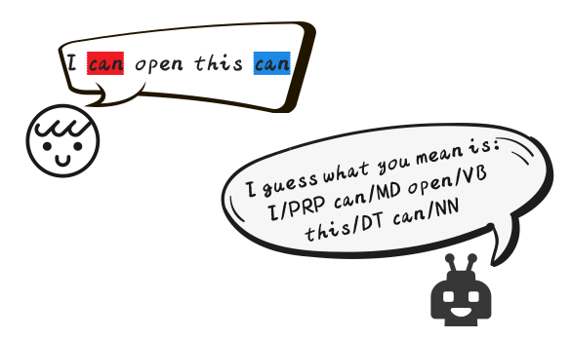
Syntactic tasks: Word level
Part-of-speech (POS)
Basic syntactic role that words play in a sentence

Slide 13
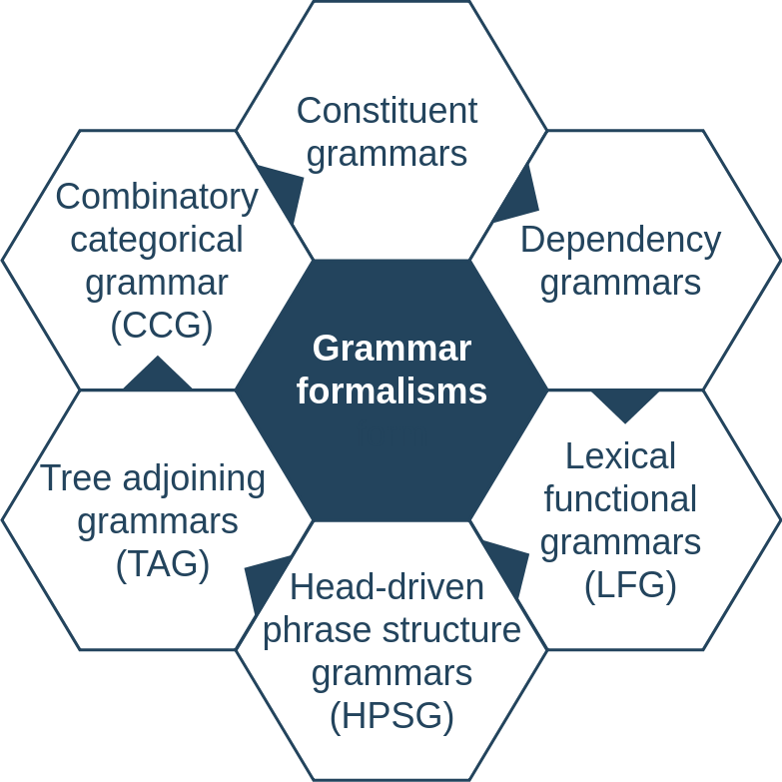
Syntactic tasks: Sentence level
Grammar formalisms for syntactic parsing:

Slide 14
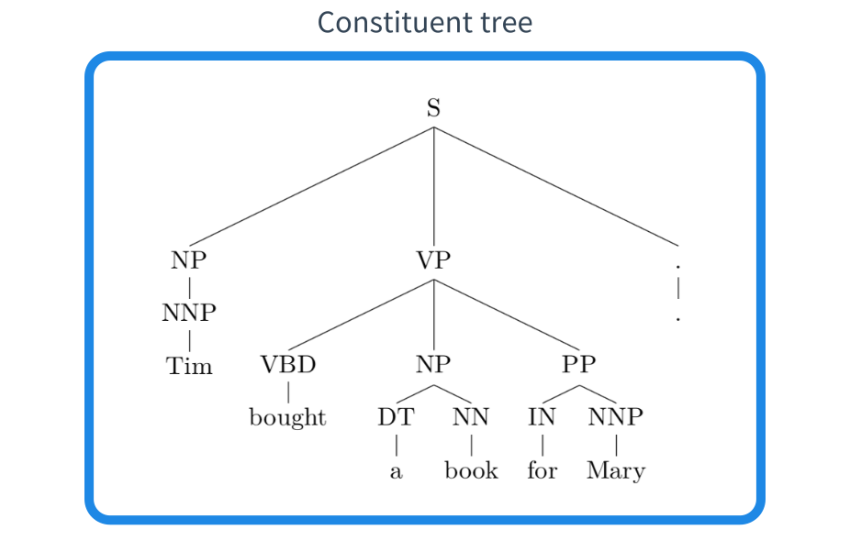
Constituent parsing
Constituent parsers assign phrase labels to constituent, also referred to as phrase-structure grammars.

Slide 15
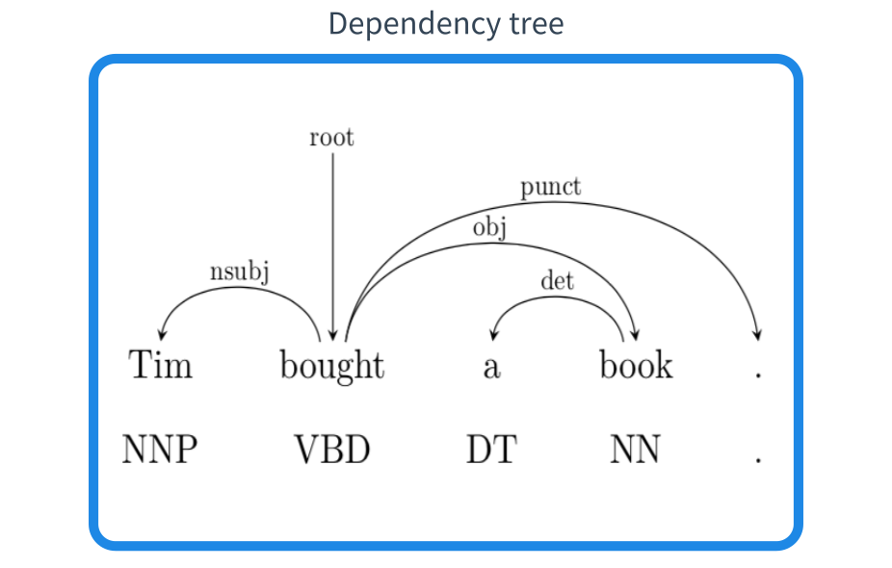
Dependency parsing
Dependency parsers analyze a sentence in head words and dependent words.

Slide 16
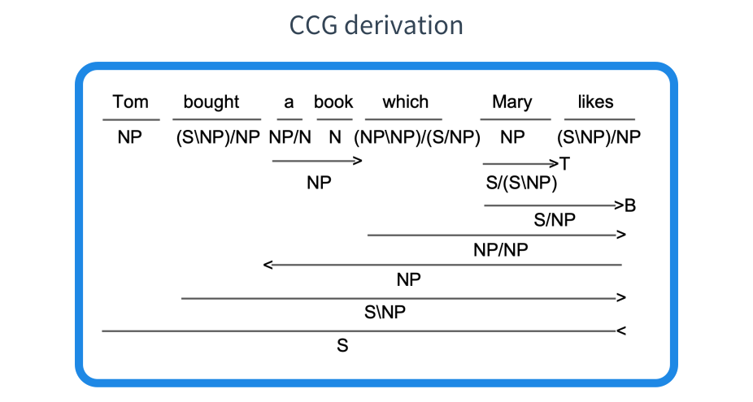
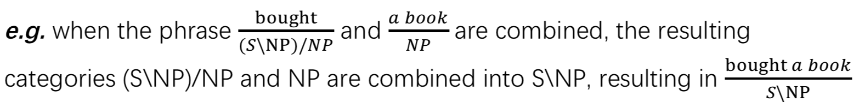
CCG parsing
Lexical categories (e.g. NP, N, S\NP)
Composition rules

Slide 17
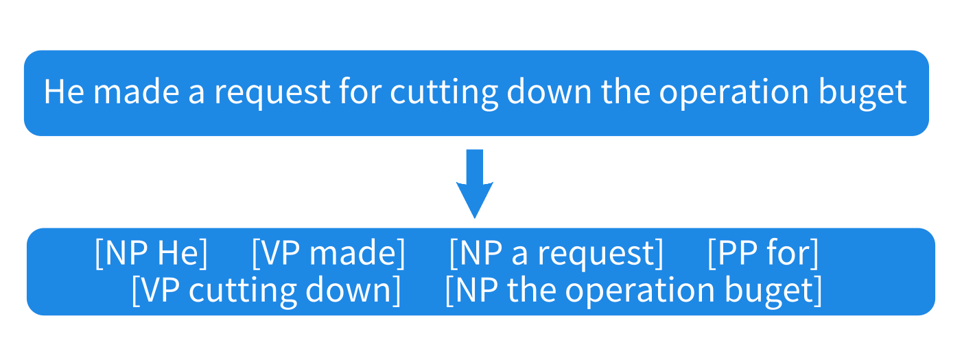
Supertagging
Also called shallow parsing, a pre-processing step before parsing.
CCG supertagging
Syntactic chunking
identify basic syntactic phrases from a given sentence.

Slide 18
Semantic tasks: Word level
Word sense disambiguation (WSD)
Never trouble troubles till trouble troubles you.
I saw a man saw a saw with a saw.
Metaphor
Love is a battlefield.
Bob is a couch potato.

Slide 19
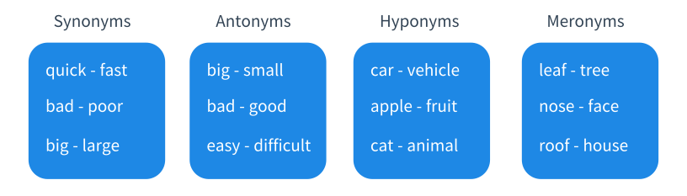
Semantic tasks: Word level
Sense relations between words
Analogy
king – queen / man – woman / boy – girl

Slide 20
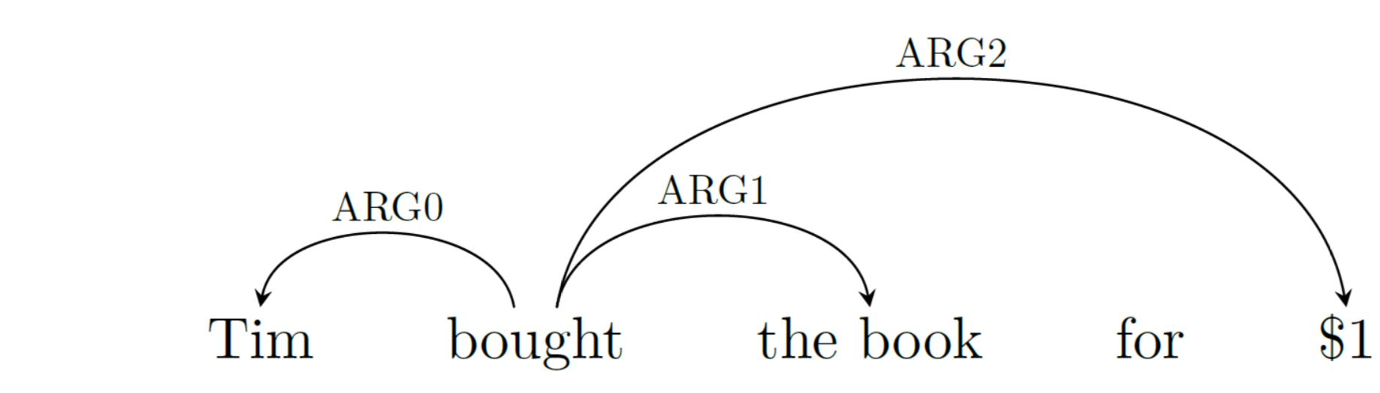
Semantic tasks: Sentence level
Predicate-argument relations (semantic role labeling)
Tim bought this book for $1.

Slide 21
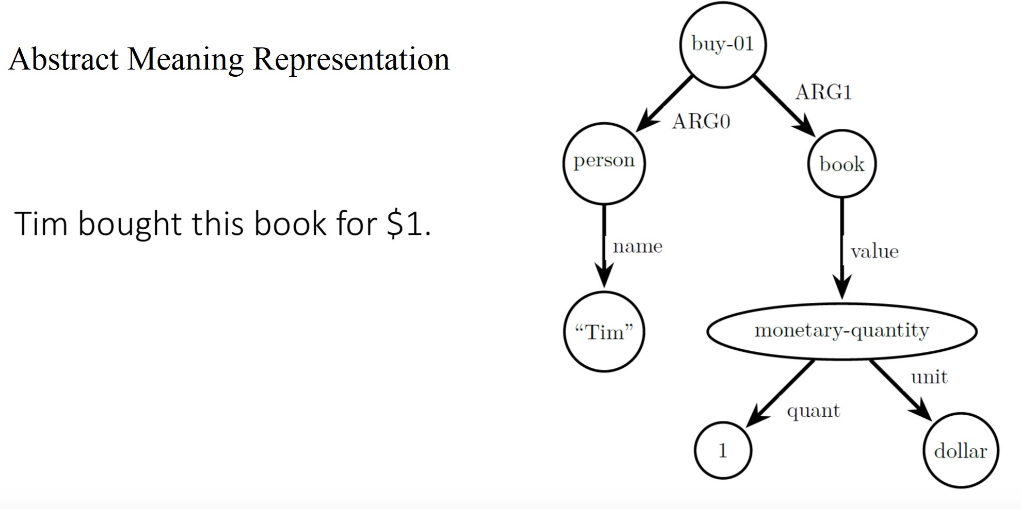
Semantic graphs
Abstract Meaning Representation
Tim bought this book for $1.

Slide 22
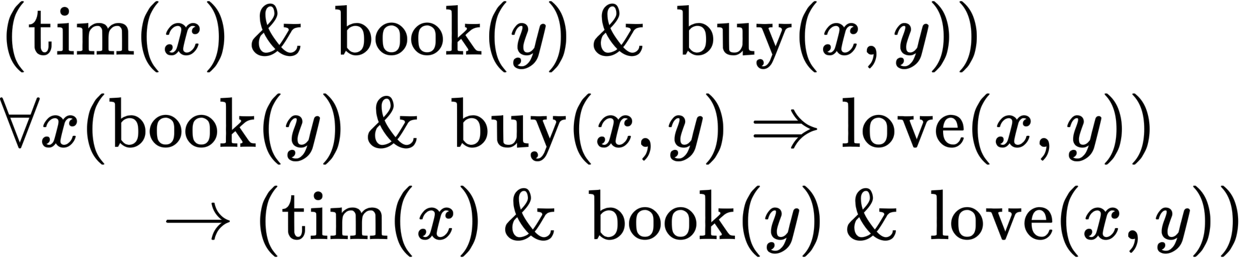
Logic
“Everyone who bought this book loves it.”
“Tim bought this book.”,
We can infer that “Tim loves this book.”

Slide 23
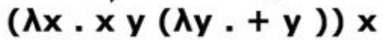
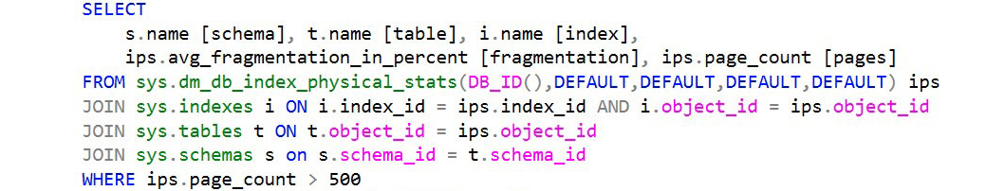
More Semantic Parsing Cases
Lambda calculus
Text to SQL

Slide 24
Text entailment
a directional semantic relation between two texts
Text: Tim went to the Riverside for dinner
Hypotheses1: The Riverside is an eating place ------------ True
Hypotheses2: Tim had dinner --------------------------------- True
Hypotheses3: Tom had lunch --------------------------------- False
Hypotheses4: Tim did not have dinner ----------- Contradiction

Slide 25
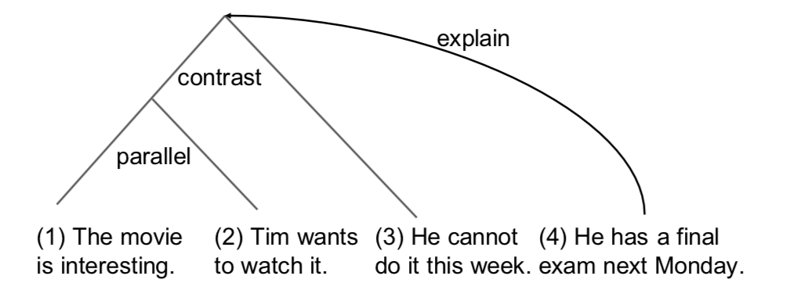
Discourse tasks
Discourse: multiple sub-topics and coherence relations
Discourse parsing: Analyze the coherence relations between sub-topics in a discourse. Rhetoric structure theory

Slide 26
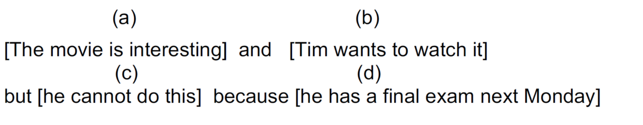

Discourse segmentation

Slide 27
Contents
1.1 What is Natural Language Processing (NLP)?
1.2 NLP tasks
1.2.1 Fundamental NLP tasks
1.2.2 Information Extraction tasks
1.2.3 Text generation Tasks
1.2.4 Other Applications
1.3 NLP from a Machine Learning Perspective

Slide 28
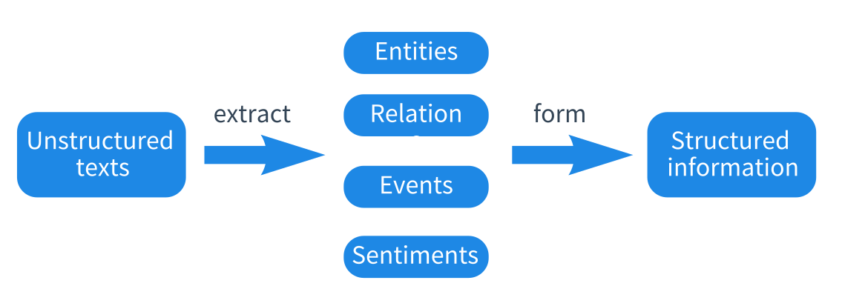
Information extraction (IE)
Obtain structured information from unstructured texts.

Slide 29
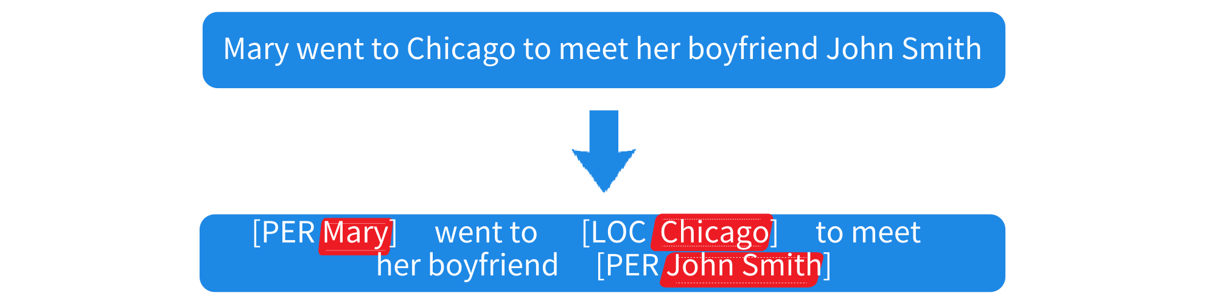
Entities
Named entity recognition (NER)
To identify all named entity mentions from a given piece of text

Slide 30


Anaphora Resolution
resolves what a pronoun or noun phrase refers to
Zero-pronoun resolution
detects and interprets dropped pronouns

Slide 31
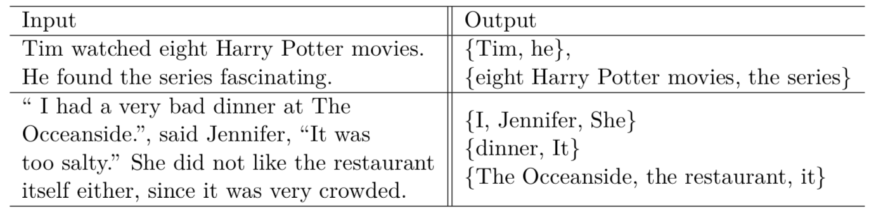
Co-references
Co-reference resolution
finds all expressions that refer to the same entities in a text

Slide 32

Relations
Relations between entities represent knowledge
common relations
hierarchical
domain-specific

Slide 33
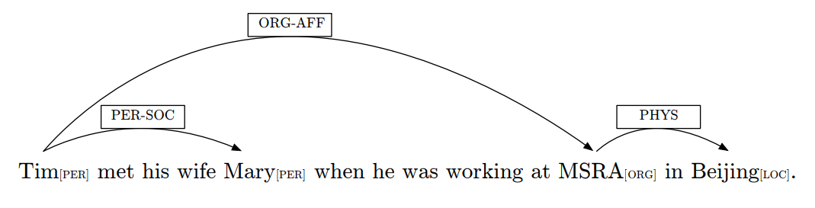
Relations
Relation extraction
identify relations between entity under a set of pre-specified relation categories.

Slide 34
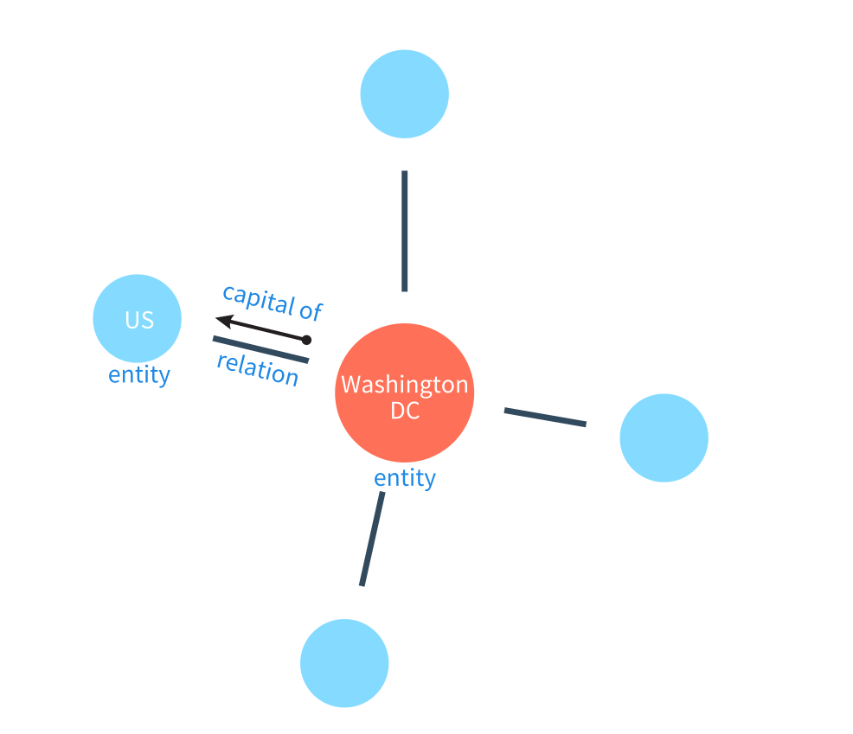
Knowledge graph
a type of databases, entities form nodes and relations form edges.

Slide 35

Knowledge graph
Entity linking (entity disambiguation)
determines the identity of entity mentioned from text.
Related task: Named entity normalization
finds a canonical term for named entity mentions

Slide 36
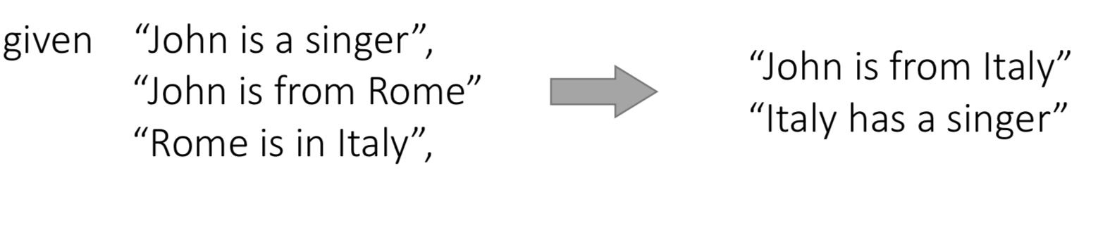
Knowledge graph
Link prediction (knowledge graph completion)
Knowledge graphs allow knowledge inference.

Slide 37
Events
Event Detection
Trigger word: “Trump visited Tokyo.”
“Trump’s Tokyo visit has finished.”
Event type classification
“DIPLOMATIC VISIT”
Argument extraction
“VISITOR=Trump”

Slide 38
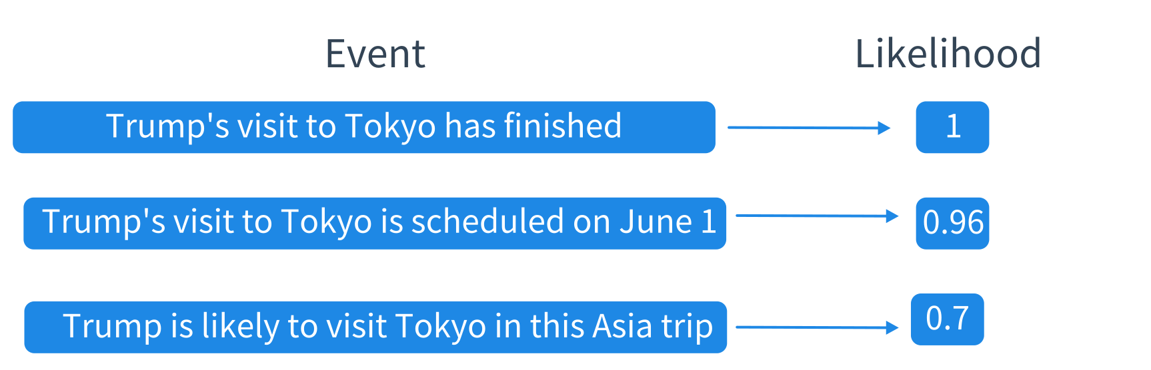
Events
News event detection (first story detection)
Event factuality prediction (predict the likelihood of event)
Event time extraction (e.g. temporal ordering of events)
Causality detection

Slide 39
Events
Event coreference resolution
“I interviewed Mary yesterday. It went very smooth.”
“it” refers to the interviewing event
Zero-pronouns
" Mary went to Russia to see the World Cup. Tom too." verb phrase ellipsis

Slide 40
Events
Script learning
aims to extract a set of partially ordered events knowledge
In the scenario "restaurant visiting"
"customer to be seated"
"customer to order food"
"waiter to serve food"
"customer to eat food"
"customer to pay"

Slide 41
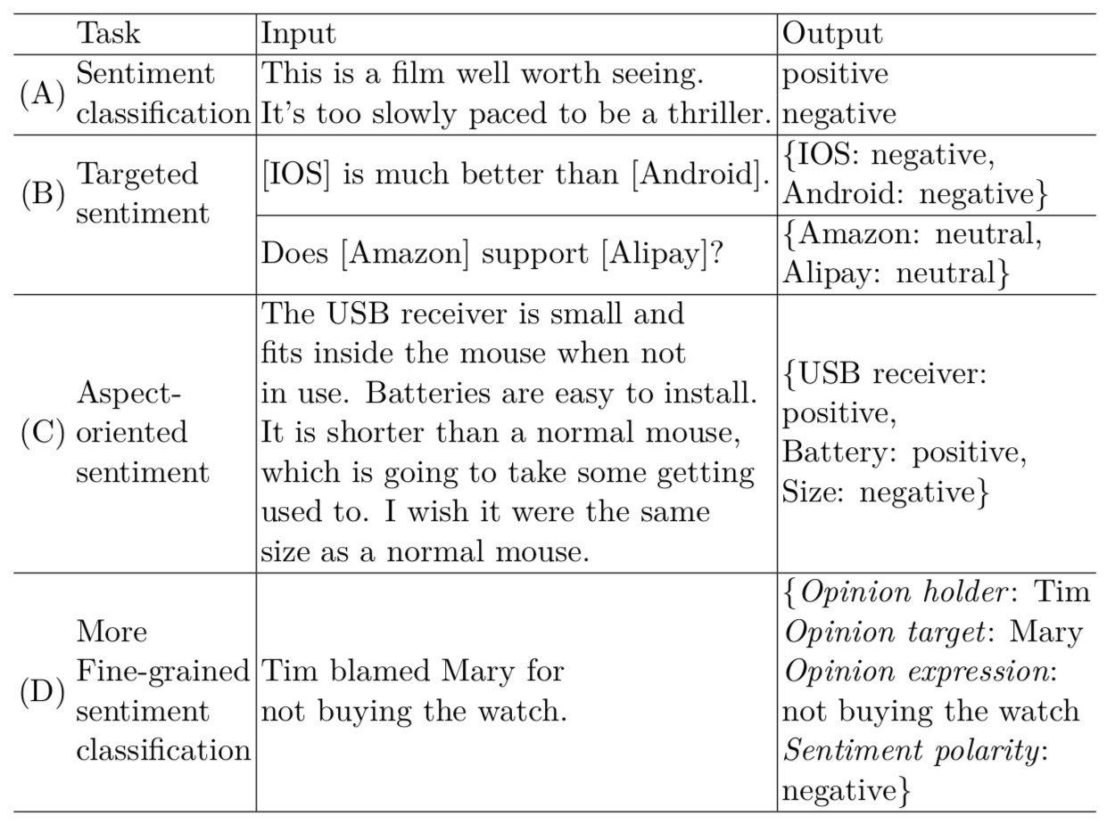
Sentiment analysis (opinion mining)

Slide 42
Sentiment related tasks
Sarcasm detection
"Like you care!“
Sentiment lexicon acquisition
lexicons that contain sentiment-baring words, polarities and strengths
Emotion detection
"anger","disappointed","excited"

Slide 43
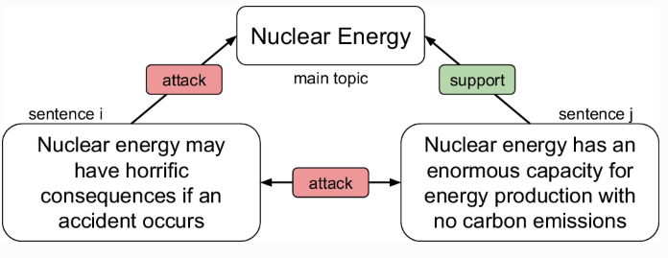
Sentiment related tasks
Stance detection and argumentation mining
"for","against“

Slide 44
Contents
1.1 What is Natural Language Processing (NLP)?
1.2 NLP tasks
1.2.1 Fundamental NLP tasks
1.2.2 Information Extraction tasks
1.2.3 Text generation Tasks
1.2.4 Other Applications
1.3 NLP from a Machine Learning Perspective

Slide 45
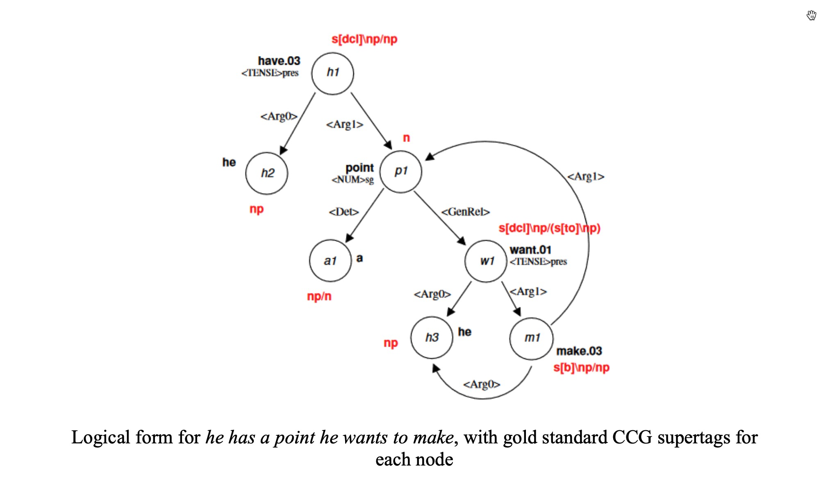
Realization
The generation of natural language text from syntactic/semantic representations
Semantic dependency graphs (logical forms) example:
CCG Realization with LSTM Hypertagging. Reid Jerry Fu, BS

Slide 46
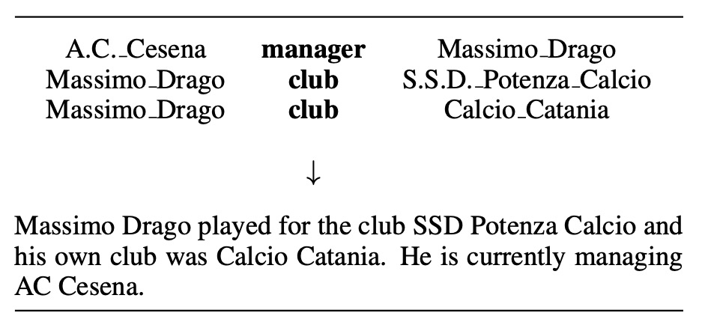
Data-to-text Generation
The generation of natural language text from syntactic/semantic representations
Example of a set of triples and the corresponding text:
Neural data-to-text generation: A comparison between pipeline and end-to-end architectures. Thiago Castro Ferreira et, al.

Slide 47
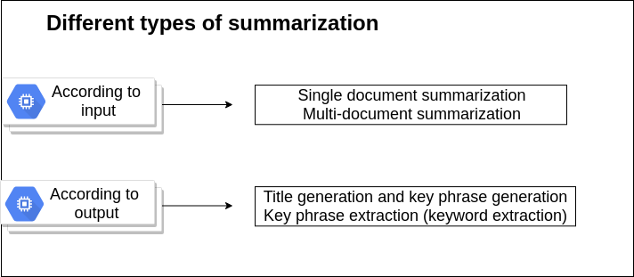
Summarization
Extractive summarization
Abstractive summarization

Slide 48
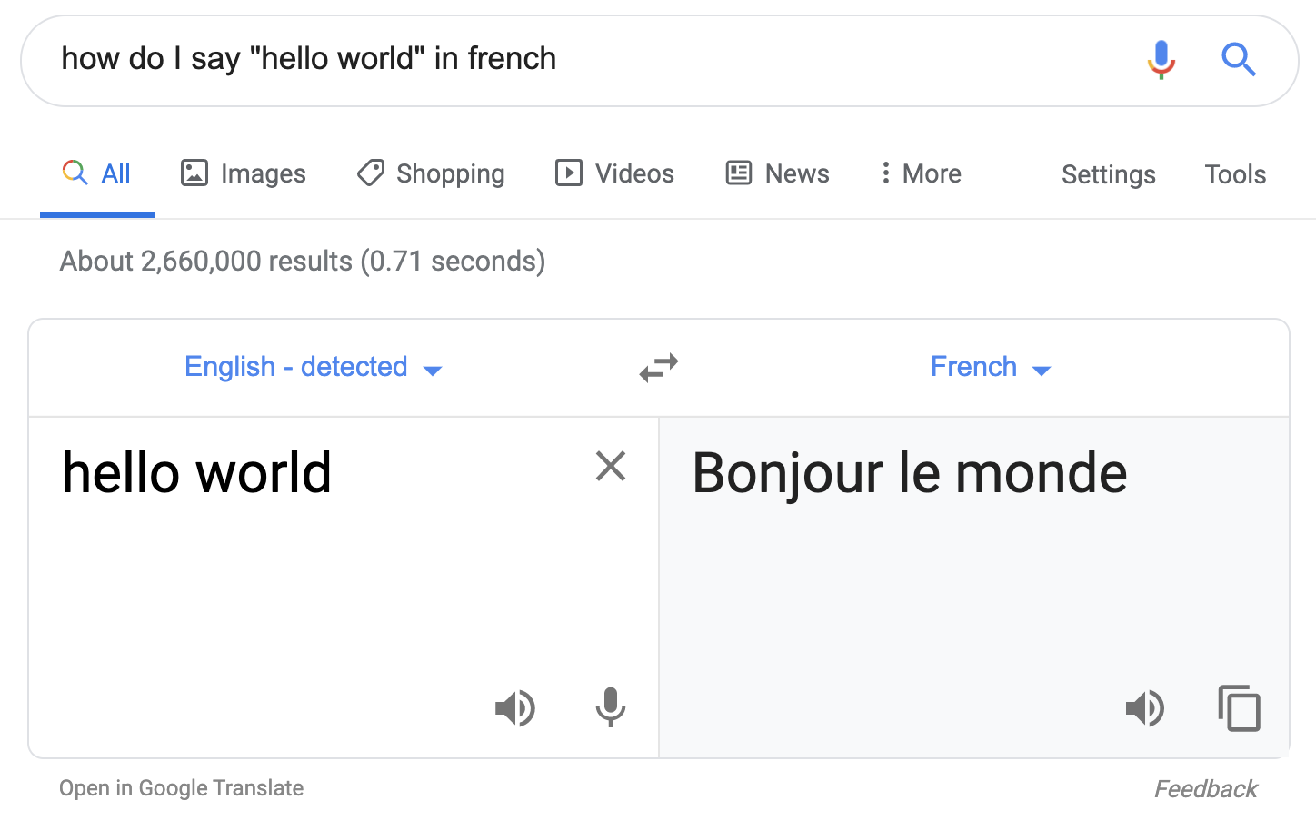
Machine translation

Slide 49
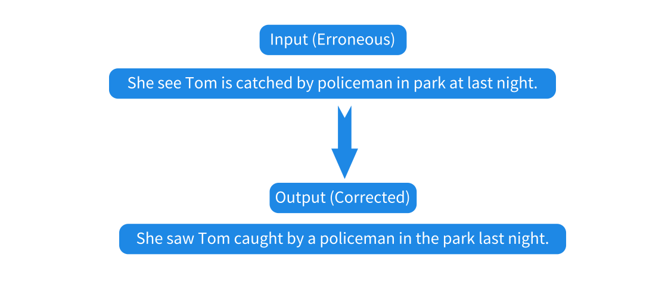
Grammar error correction
Grammar error detection
Disfluency detection
Writing quality assessment

Slide 50
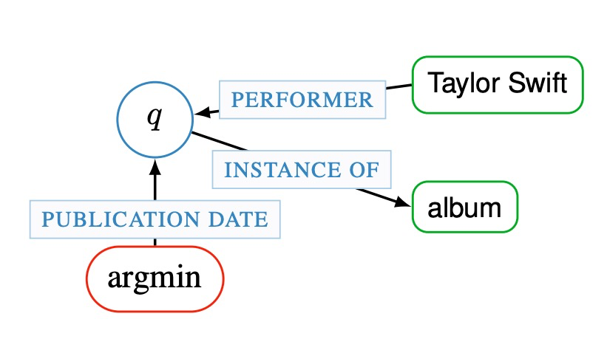
Question answering (QA)
Knowledge-base QA
A semantic graph for an example question “What was the first Taylor Swift album?”
Modeling Semantics with Gated Graph Neural Networks for Knowledge Base Question Answering. Daniil Sorokin et al.

Slide 51
Question answering (QA)
Reading comprehension (machine reading)
answer questions in interpretive ways
An example from the Stanford Question Answering Dataset (SQuAD):
Conventionally, a computer consists of at least one processing element, typically a central processing unit (CPU), and some form of memory. The processing element carries out arithmetic and logic operations, and a sequencing and control unit can change the order of operations in response to stored information. Peripheral devices allow information to be retrieved from an external source, and the result of operations saved and retrieved.
In computer terms, what does CPU stand for?
What are the devices called that are from an external source?
What are two things that a computer always has?
SQuAD: 100,000+ Questions for Machine Comprehension of Text. Pranav Rajpurkar et al.

Slide 52
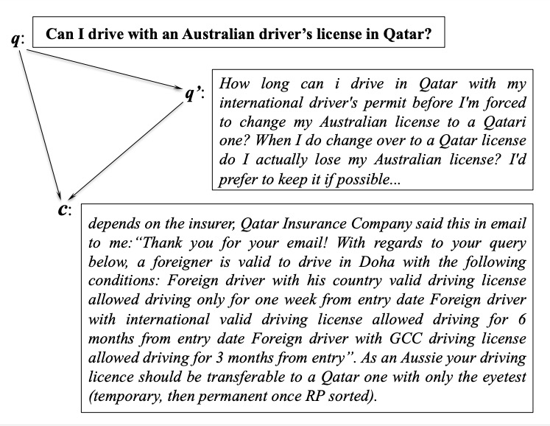
Question answering (QA)
Community QA
An example of Question Answering from website forum showing three pairwise interactions
Between the original question q, the related qustion q’, and a comment c in the related question
thread.
SemEval-2017 Task 3: Community Question Answering. Preslav Nakov et al.

Slide 53
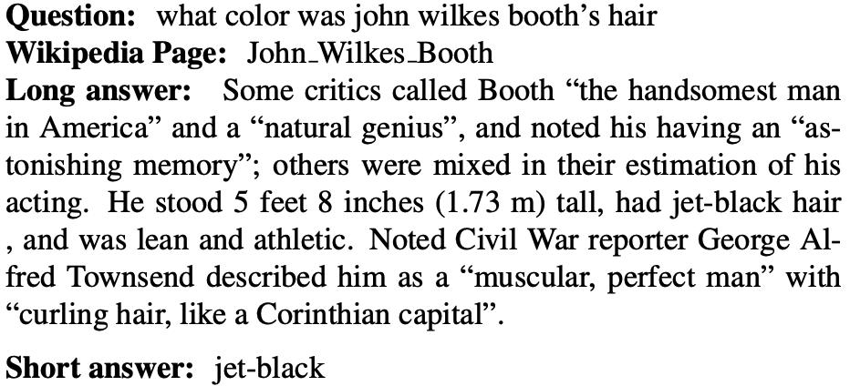
Question answering (QA)
Open QA
An example from the Natural Questions corpus:
Natural Questions: a Benchmark for Question Answering Research. Kwiatkowski et al.

Slide 54
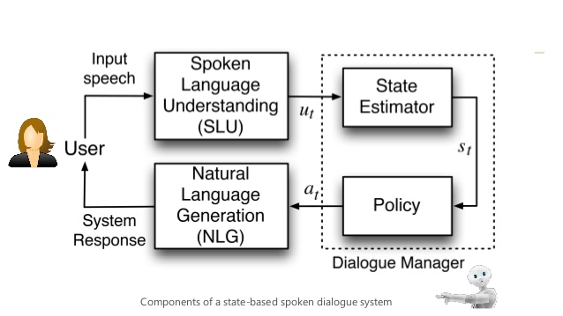
Dialogue systems
Chit-chat
Task-oriented dialogues

Slide 55
Contents
1.1 What is Natural Language Processing (NLP)?
1.2 NLP tasks
1.2.1 Fundamental NLP tasks
1.2.2 Information Extraction tasks
1.2.3 Text generation Tasks
1.2.4 Other Applications
1.3 NLP from a Machine Learning Perspective

Slide 56
Information retrieval
Text classification / text clustering
Text topics classification
"finance","sports","Tech"...
Spam detection
email spam
Opinion spam detection
whether a review contains deceptive false opinions
Language identification
"French","English“
Rumor detection
false statement
Humor detection

Slide 57
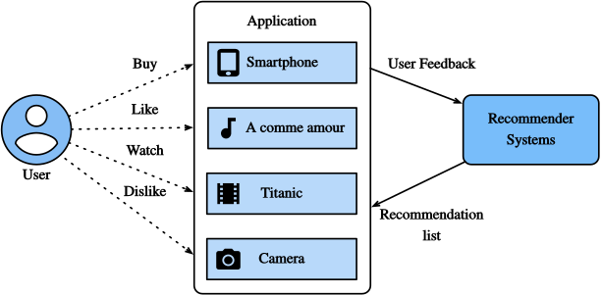
Recommendation system
leverage text reviews for recommending

Slide 58
Text mining and text analytics
derive high-quality information from text
Clinical decision assistance
Stock market prediction
Movie revenue prediction
Presidential election results prediction

Slide 59
Contents
1.1 What is Natural Language Processing (NLP)?
1.2 NLP tasks
1.2.1 Fundamental NLP tasks
1.2.2 Information Extraction tasks
1.2.3 Text generation Tasks
1.2.4 Other Applications
1.3 NLP from a Machine Learning Perspective

Slide 60
Machine learning perspective
The current dominant method
The historical of research

Slide 61

Machine learning perspective
NLP tasks are many and dynamically evolving, but fewer according to machine learning nature
Classification
Output is a distinct label from a set
Structure prediction
Outputs are structures with inter-related sub structures
Regression
Output is a real valued number, e.g. predicting stock prices

Slide 62
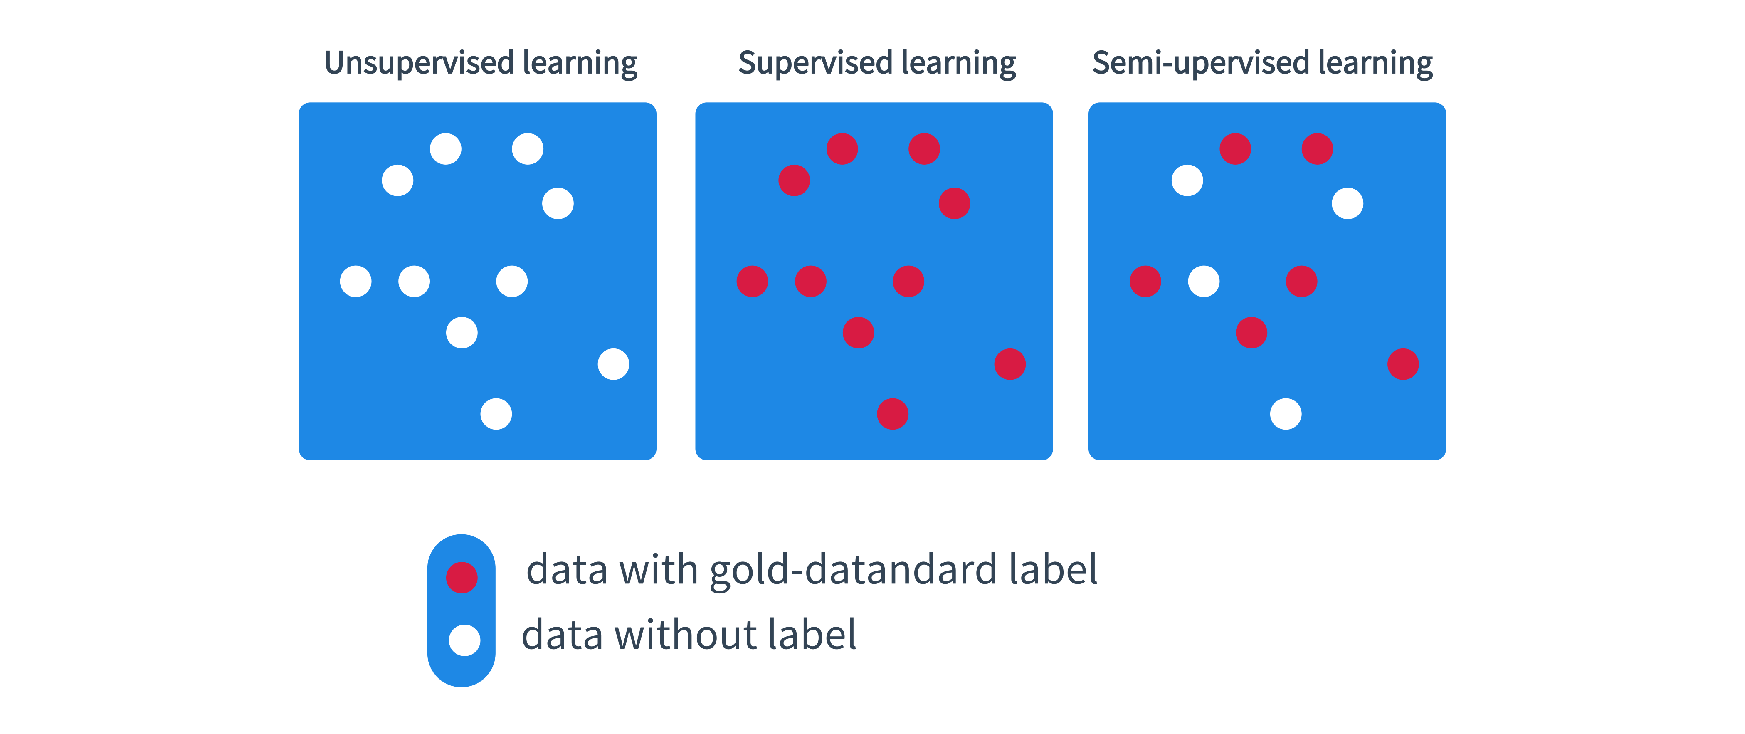
Categorized by the training data
Unsupervised learning
data without human annotation
Supervised learning
data with human annotated gold-standard output labels
Semi-supervised learning
both data with labels and data without annotation

Slide 63
Summary
What is Natural Language Processing (NLP)
A spectrum of NLP problems
NLP from a machine learning perspective

Slide 64
Resources
NLP toolkits
NLTK - leading platform for text processing libraries and corpora
https://www.nltk.org
AllenNLP - NLP research library built on PyTorch
https://allennlp.org/
Stanford's Core NLP Suite
http://nlp.stanford.edu/software/corenlp.shtml
Huggingface Transformer - pretrained models ready to use
https://github.com/huggingface/transformers

Slide 65
Resources
Word level syntax
POS tagging online:
https://part-of-speech.info
The Stanford log-linear POS tagger https://nlp.stanford.edu/software/tagger.html
NLP4j - robust POS tagging using dynamic model selection https://emorynlp.github.io/nlp4j/
Flair - with a state-of-the-art POS tagging model
https://github.com/zalandoresearch/flair/

Slide 66
Resources
Syntax
spaCy - industrial-strength NLP in python, for parsing and more https://spacy.io/
phpSyntaxTree - generate graphical syntax trees http://ironcreek.net/phpsyntaxtree/
The Stanford Parser
https://nlp.stanford.edu/software/lex-parser.html
Penn Treebank
https://www.sketchengine.eu/penn-treebank-tagset/
CCGBank
http://groups.inf.ed.ac.uk/ccg/ccgbank.html

Slide 67
Resources
Lexical semantics
WordNet - the de-facto sense inventory for English https://wordnet.princeton.edu/
Open Mind Word Expert sense-tagged data
http://www.cse.unt.edu/~rada/downloads.html#omwe
CuiTools - a complete word sense disambiguation system
http://sourceforge.net/projects/cuitools/
WDS Gate - a WSD toolkit using GATE and WEKA
http://sourceforge.net/projects/wsdgate/
SEMPRE - a toolkit for training semantic parsers https://nlp.stanford.edu/software/sempre/

Slide 68
Resources
Semantic roles
PropBank - the proposition bank
https://propbank.github.io/
Implied Relationships - predicate argument relationships
http://u.cs.biu.ac.il/~nlp/resources/
Logic
GEO880
http://www.cs.utexas.edu/users/ml/nldata/geoquery.html
DeepMind logical entailment dataset
https://github.com/deepmind/logical-entailment-dataset

Slide 69
Resources
AMR
AMR - abstract meaning representation
https://amr.isi.edu/
Segrada - semantic graph database
https://segrada.org/
Text entailment
The Stanford Natural Language Inference (SNLI) Corpus
https://nlp.stanford.edu/projects/snli/
MultiNLI - the multi-genre NLI corpus
https://www.nyu.edu/projects/bowman/multinli/

Slide 70
Resources
Discourse segmentation
PDTB - Penn Discourse Treebank
https://www.seas.upenn.edu/~pdtb/
Prague Discourse Treebank - annotation of discourse relations
https://ufal.mff.cuni.cz/pdit2.0

Slide 71
Resources
NER
Stanford Named Entity Recognizer (NER)
https://nlp.stanford.edu/software/CRF-NER.html
OpeNER - open Polarity Enhanced Name ENtity Recognition
https://www.opener-project.eu/
CoNLL 2003 language-indenpendent named entity recognition
http://www.cnts.ua.ac.be/conll2003/ner/
OntoNotes
https://catalog.ldc.upenn.edu/LDC2013T19
MUC-3 and MUC-4 datasets
http://www.itl.nist.gov/iaui/894.02/related_projects/muc/

Slide 72
Resources
Co-reference
BART coreference system
http://www.bart-coref.org/
CherryPicker - a coreference resolution tool with cluster ranker
http://www.hlt.utdallas.edu/~altaf/cherrypicker/

Slide 73
Resources
Relation extraction
The NewYorkTimes(NYT) - supervised relationship extraction
https://catalog.ldc.upenn.edu/LDC2008T19
ACE2004 - multilingual training corpus
https://catalog.ldc.upenn.edu/LDC2005T09
SemWval2010
http://semeval2.fbk.eu/
TACRED - relation extraction dataset built on newswire, web text
https://nlp.stanford.edu/projects/tacred/
RewRel - the largest supervised relation classification dataset
http://www.zhuhao.me/fewrel/

Slide 74
Resources
Knowledge graph
Microsoft Text Analytics
https://labs.cognitive.microsoft.com/en-us/project-entity-linking
Dexter - a open source framework for entity linking
http://dexter.isti.cnr.it/
neleval - for named entity liking and coreference resolution
https://pypi.org/project/neleval/

Slide 75
Resources
Events
ACE(KBP) automatic content extraction
https://cs.nyu.edu/grishman/jet/guide/ACEstructures.html
TimeBank 1.2
https://catalog.ldc.upenn.edu/LDC2006T08
TAC KBP 2017 - event tracking
https://tac.nist.gov/2017/KBP/data.html
Story Cloze Test corpora
http://cs.rochester.edu/nlp/rocstories/

Slide 76
Resources
Sentiment
The Stanford Sentiment Treebank(SST) - movie reviews
https://nlp.stanford.edu/sentiment/index.html
MPQA - news articles manually annotated for opinions
http://mpqa.cs.pitt.edu/corpora/
SemEval17 - consist of 5 subtasks, both Arabic and English
http://www.aclweb.org/anthology/S17-2088
The IMDb dataset - reviews from IMDb with label
https://kaggle.com/carolzhangdc/imdb-5000-movie-dataset
MeaningCloud
Https://www.meaningcloud.com

Slide 77
Resources
Machine translation
Workshop on Statistical Machine Translation (WMT)
http://www.statmt.org/wmt14/translation-task.html
International Workshop on Spoken Language Translation (IWSLT)
http://workshop2015.iwslt.org/
OpenNMT - open source neural machine translation
http://opennmt.net/
BinQE - a machine translation dataset annotated with binary quality
judgements
https://ict.fbk.eu/binqe/
T2T for neural translation
https://github.com/tensorflow/tensor2tensor

Slide 78
Resources
Summarization
The CNN / Daily Mail dataset - training machine reading systems
https://arxiv.org/abs/1506.03340
Grammar error correction
CoNLL-2014 Shared Task - benchmark GEC systems
https://www.comp.nus.edu.sg/~nlp/conll14st/

Slide 79
Resources
QA
CoQA - a conversational question answering dataset
https://stanfordnlp.github.io/coqa/
QBLink - sequential open-domain question answering
https://sites.google.com/view/qanta/projects/qblink
DrQA: Open Domain Question Answering
https://github.com/facebookresearch/DrQA
DocQA: Multi-Paragraph Reading Comprehension by AllenAI
https://github.com/allenai/document-qa

Slide 80
Resources
Dialogue system
MultiWOZ (2018) - for goal-driven dialogue system
http://dialogue.mi.eng.cam.ac.uk/index.php/corpus/
DailyDialog Dataset (2017)
http://yanran.li/dailydialog
DeepPavlov - open-source library for dialogue systems
https://deeppavlov.ai/
KVRET - multi-turn, multi-domain, task-oriented dialogue dataset
https://nlp.stanford.edu/blog/a-new-multi-turn-multi-domain-taskoriented-dialogue-dataset/

Slide 81
Resources
Recommendation system
Amazon product review
http://jmcauley.ucsd.edu/data/amazon/
Case Recommender - recommender tool
https://github.com/caserec/CaseRecommender
MyMediaLife - recommender system library
http://www.mymedialite.net/
LIBMF - a matrix-factorization library for recommender system
https://www.csie.ntu.edu.tw/~cjlin/libmf/

Slide 82
Resources
Text mining and text analytics
GATE - general architecture for text engineering
https://gate.ac.uk/
OpenNLP - Apache OpenNLP library
https://opennlp.apache.org/
LingPipe - tool kit for processing text
http://alias-i.com/

